Slide 1


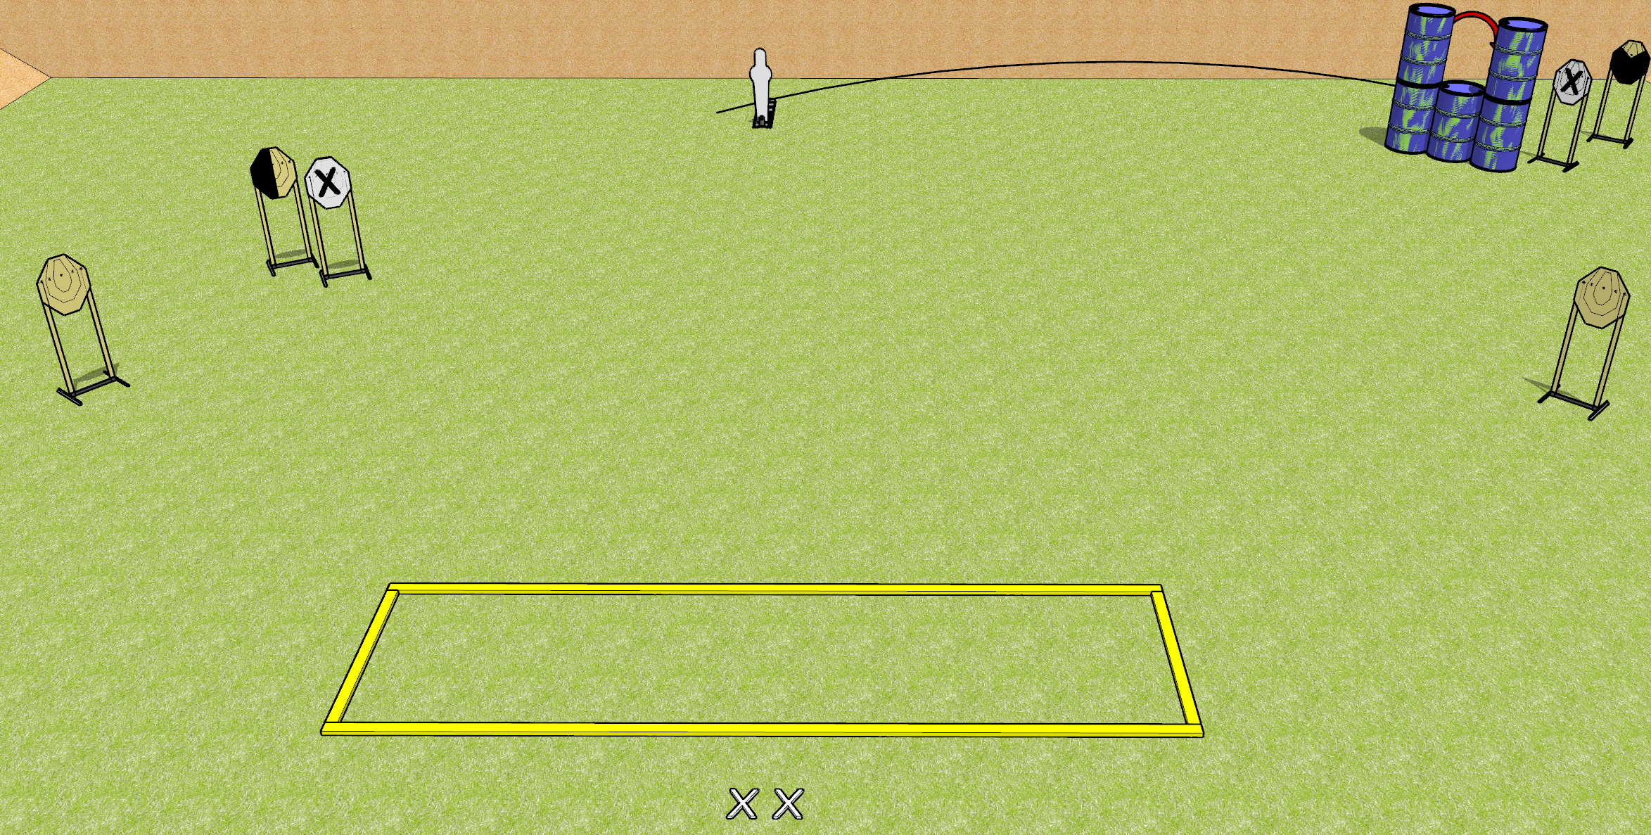
 | Dothan Gun Club – USPSA Match Now You See Me Course Designer : Drew Coleman
START POSITION : Standing with both feet on X’s, wrists below belt
GUN READY CONDITION : Pistol loaded and holstered. PCC loaded, shouldered, safety on, pointed at orange cone. |  | SCORING: Comstock, 11 rounds TARGETS: 5 paper, 1 Steel SCORED HITS: Best 2 on paper, steel until down START-STOP: Audible, last shot RULES:
STAGE PROCEDURE: Engage targets as they become available from within the fault lines.

